Slide 1

OVERVIEW
Notes:
shape
No alt text provided
textbox
No alt text provided
image
No alt text provided
textbox
No alt text provided
image
No alt text provided
shape
No alt text provided
shape
No alt text provided
shape
No alt text provided
textbox
No alt text provided
image
No alt text provided

Slide 2
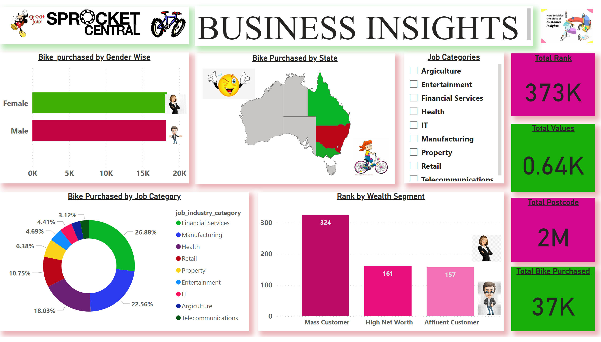
BUSINESS INSIGHTS
Notes:
Bike_purchased by Gender Wise
No alt text provided
image
No alt text provided
image
No alt text provided
Rank by Wealth Segment
No alt text provided
Bike Purchased by State
No alt text provided
Job Categories
No alt text provided
Bike Purchased by Job Category
No alt text provided
Total Rank
No alt text provided
Total Values
No alt text provided
Total Postcode
No alt text provided
Total Bike Purchased
No alt text provided
image
No alt text provided
image
No alt text provided
image
No alt text provided
image
No alt text provided
image
No alt text provided
image
No alt text provided
textbox
No alt text provided
image
No alt text provided
image
No alt text provided

Slide 3
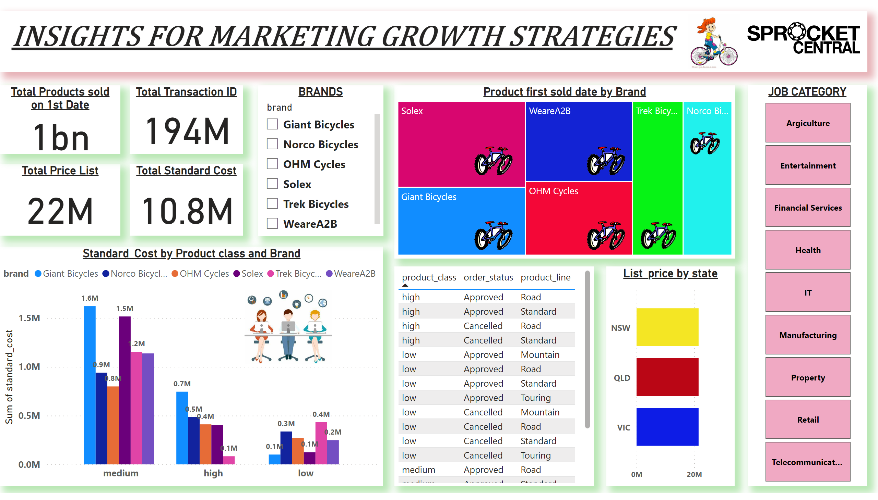
ADDITIONAL INSIGHTS
Notes:
Standard_Cost by Product class and Brand
No alt text provided
Product first sold date by Brand
No alt text provided
tableEx
No alt text provided
Total Price List
No alt text provided
Total Products sold on 1st Date
No alt text provided
Total Transaction ID
No alt text provided
Total Standard Cost
No alt text provided
BRANDS
No alt text provided
textbox
No alt text provided
List_price by state
No alt text provided
JOB CATEGORY
No alt text provided
image
No alt text provided
image
No alt text provided
image
No alt text provided
image
No alt text provided
image
No alt text provided
image
No alt text provided
image
No alt text provided
image
No alt text provided
image
No alt text provided

